Slide 1
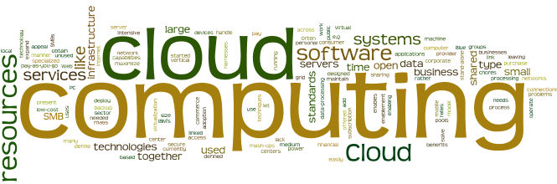
Cloud Computing Essentials and Actors

Slide 2
Module Objectives
You should able to answer below questions end of this module.
What is cloud computing ?
What are the cloud computing essential parts ?
Who are the cloud actors ( stakeholders) and what they do?
How do you deploy cloud services?
Notes:
Virtualization is an evolving technology in the IT world. Virtualization is being used by a growing number of organizations to consolidate their workloads, to make their IT environments scalable and more flexible.

Slide 3
What is Cloud Computing ?
Official NIST definition,
"cloud computing is a model for enabling ubiquitous, convenient, on-demand network access to a shared pool of configurable computing resources (e.g., networks, servers, storage, applications and services) that can be rapidly provisioned and released with minimal management effort or service provider interaction.“
On Demand Self Service
Broad Network Access

Slide 4
What is Cloud Computing ? (Continued)
Official NIST definition,
"cloud computing is a model for enabling ubiquitous, convenient, on-demand network access to a shared pool of configurable computing resources (e.g., networks, servers, storage, applications and services) that can be rapidly provisioned and released with minimal management effort or service provider interaction.“
3. Resource pooling or shared services

Slide 5
What is Cloud Computing ? (Continued..)
Official NIST definition,
"cloud computing is a model for enabling ubiquitous, convenient, on-demand network access to a shared pool of configurable computing resources (e.g., networks, servers, storage, applications and services) that can be rapidly provisioned and released with minimal management effort or service provider interaction.“
4 .Rapid elasticity

Slide 6
What is Cloud Computing ? (Cont.)
Official NIST definition,
"cloud computing is a model for enabling ubiquitous, convenient, on-demand network access to a shared pool of configurable computing resources (e.g., networks, servers, storage, applications and services) that can be rapidly provisioned and released with minimal management effort or service provider interaction.“
5. Measured Services

Slide 7
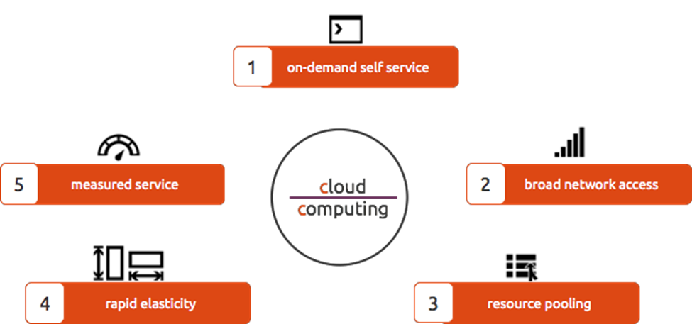
Essential Characteristic of Cloud Computing
1.On-Demand Self Service
2.Broad Network Access On
3.Resource pooling or shared services
4.Rapid elasticity
5.Measured Services

Slide 8

On-Demand Self Service
A consumer can unilaterally provision computing capabilities, such as
server time and network storage, as needed automatically without requiring human
interaction with each service provider.

Slide 9

Broad Network Access
Capabilities are available over the network and accessed through standard
mechanisms that promote use by heterogeneous thin or thick client platforms (e.g.,
mobile phones, tablets, laptops, and workstations)

Slide 10

Resource Pooling or Shared Services
The provider’s computing resources are pooled to serve multiple consumers
using a multi-tenant model, with different physical and virtual resources dynamically
assigned and reassigned according to consumer demand. There is a sense of location
independence in that the customer generally has no control or knowledge over the exact location of the provided resources but may be able to specify location at a higher level of abstraction (e.g., country, state, or datacenter). Examples of resources include storage, processing, memory, and network bandwidth

Slide 11

Rapid Elasticity
Capabilities can be elastically provisioned and released, in some cases
automatically, to scale rapidly outward and inward commensurate with demand. To the consumer, the capabilities available for provisioning often appear to be unlimited and can be appropriated in any quantity at any time

Slide 12

Measured Services
Cloud systems automatically control and optimize resource use by leveraging
a metering capability at some level of abstraction appropriate to the type of service (e.g., storage, processing, bandwidth, and active user accounts).
Resource usage can be monitored, controlled, and reported, providing transparency for both the provider and consumer of the utilized service.

Slide 13
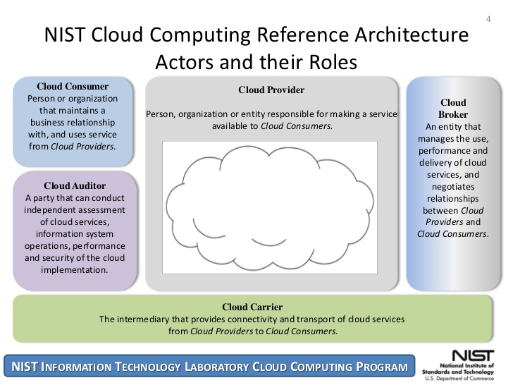
Actors in Cloud
The NIST cloud computing reference architecture defines five major actors:
Cloud consumer
Cloud provider
Cloud auditor
Cloud broker
Cloud carrier
A cloud consumer may request cloud services from a cloud provider directly or via a cloud broker.
A cloud auditor conducts independent audits and may contact the others to collect necessary information.

Slide 14
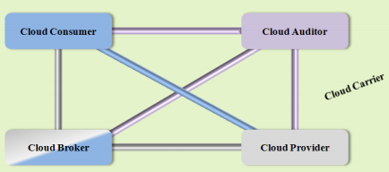
Actors in Cloud : Cloud Carrier
Cloud carriers provide access to consumers through network, telecommunication and other access devices.
For example, cloud consumers can obtain cloud services through network access devices, such as computers, laptops, mobile phones, mobile internet devices (MIDs), etc.
The distribution of cloud services is normally provided by network and telecommunication carriers or a transport agent, where a transport agent refers to a business organization that provides physical transport of storage media such as high-capacity hard drives.
Cloud provider can set up SLAs with a cloud carrier to provide services consistent with the level of SLAs offered to cloud consumers.

Slide 15
Actors in Cloud : Cloud Auditor
Audits are performed to verify conformance to standards.
Auditor evaluates the security controls, privacy impact,performance, etc.
Auditing is especially important for federal agencies.
Security auditing, can make an assessment of the security controls to determine the extent to which the controls are implemented correctly, operating as intended, and producing the desired outcome. This is done by verification of the compliance with regulation and security policy.
Privacy audit helps in Federal agencies comply with applicable privacy laws and regulations governing an individual's privacy, and to ensure confidentiality, integrity, and availability of an individual's personal information at every stage of development and operation.

Slide 16
Actors in Cloud : Cloud Consumer
Cloud consumer browses & uses the service.
Cloud consumer sets up contracts with the cloud provider.
Cloud consumers need SLAs to specify the technical performance requirements fulfilled by a cloud provider.
SLAs cover the quality of service, security, remedies for performance failures.
A cloud provider list some SLAs that limit and obligate the cloud consumers by must acceptance.
Cloud consumer can freely choose a cloud provider with better pricing with favorable conditions.
Pricing policy and SLAs are non-negotiable.

Slide 17
Actors in Cloud : Cloud Broker
Integration of cloud services can be complex for consumers. Hence cloud broker, is needed.
Broker manages the use, performance and delivery of cloud services and negotiates relationships between cloud providers and cloud consumers.
In general, a cloud broker can provide services in three categories:
Service Intermediation: Broker enhances a service by improving capability and providing value-added services to consumers. The improvement can be managing access to cloud services, identity management, performance reporting, enhanced security, etc.
Service Aggregation: Broker combines and integrates multiple services into one or more new services. The broker provides data integration and ensures the secure data movement.
Service Arbitrage: It is similar to service aggregation with the flexibility to choose services from multiple agencies. For example, broker can select service with the best response time.

Slide 18
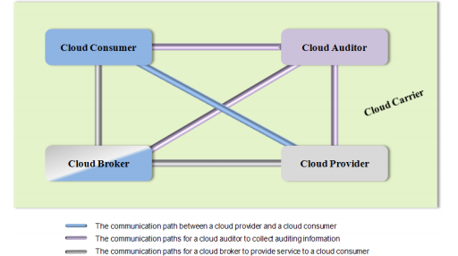
Actors in Cloud (Continued)

Slide 19
Remember ;
Cloud Consumer : A person or organization that maintains a business relationship with, and uses service from, Cloud Providers.
Cloud Provider : A person, organization, or entity responsible for making a service available to interested parties.
Cloud Auditor : A party that can conduct independent assessment of cloud services, information system operations, performance and security of the cloud implementation.
Cloud Broker : An entity that manages the use, performance and delivery of cloud services, and negotiates relationships between Cloud Providers and Cloud Consumers.
Cloud Carrier : An intermediary that provides connectivity and transport of cloud services from Cloud Providers to Cloud Consumers.

Slide 20

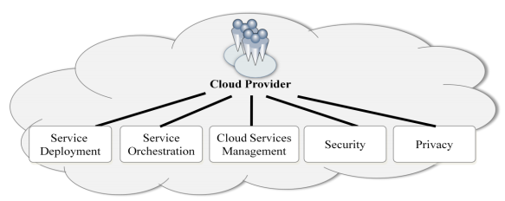
Actors in Cloud : Cloud Provider
Cloud Provider acquires and manages the computing infrastructure required for providing the services, runs the cloud software that provides the services, and makes arrangement to deliver the cloud services to the Cloud Consumers through network access.
Five major activities of Cloud Provider's
Service deployment
Service orchestration
Cloud service management
Security
Privacy

Slide 21
Actors in Cloud : Cloud Provider 1. Service Deployment
Cloud infrastructure may be operated in one of the following deployment models:
Public Cloud
Private Cloud
Community Cloud
Hybrid Cloud
<Details will be explain in Cloud models module>

Slide 22
Actors in Cloud : Cloud Provider 2. Service Orchestration
Service Orchestration refers to the composition of system components to support the Cloud Providers activities in arrangement, coordination and management of computing resources in order to provide cloud services to Cloud Consumers.
A three-layered model is used in this representation
The service layer, this is where Cloud Providers define interfaces for cloud consumers to access the computing services.(Saas, PaaS,IaaS each of the service component can stand by itself )
The resource abstraction and control layer contains the system components that cloud providers use to provide and manage access to the physical computing resources through software abstraction. Examples of resource abstraction components include software elements such as hypervisors, virtual machines, virtual data storage,
The physical resource layer includes all the physical computing resources. This layer includes hardware resources, such as computers (CPU and memory), networks (routers, firewalls, switches, network links and interfaces), storage components ( hard disks) and facility resources such as HVAC ,Power

Slide 23
Actors in Cloud : Cloud Provider 3. Service Management
Cloud Service Management includes all of the service-related functions that are necessary for the management and operation of those services required by or proposed to cloud consumers.
We have collect them in three vertical group
Business Support
Provisioning /Configuration
Portability/interoperability

Slide 24
Actors in Cloud : Cloud Provider 4. Security
Security in cloud computing architecture concerns is not solely under the purview of the cloud providers, but also cloud consumers and other relevant actors
Several generally accepted model available such as ;
Cloud Service Model Perspectives
SaaS, PaaS, and IaaS, present consumers with different types of service management operations and expose different entry points into cloud systems, which in turn also create different attacking surfaces
Implications of Cloud Deployment Models
Onside-Offsite
Tenant deployment process
Shared Security Responsibilities
Cloud providers and cloud consumers collaboratively design, build, deploy, and operate cloud-based systems. The split of control means both parties now share the responsibilities in providing adequate protections to the cloud-based systems. Security is a shared responsibility.

Slide 25
Actors in Cloud : Cloud Provider 5.Privacy
Cloud providers should protect the assured, proper, and consistent collection, processing, communication, use and disposition of personal information (PI) and personally identifiable information (PII) in the cloud
Personal Information (PI)
Information or an opinion about an identified individual, or an individual who is reasonably identifiable whether the information or opinion is true or not; and whether the information or opinion is recorded in a material form or not.
Personal Identifiable Information (PII)
Information which can be used to distinguish or trace the identity of an individual alone (e.g., name, social security number, biometric records, etc.) or when combined with other personal or identifying information which is linked or linkable to a specific individual (e.g., date and place of birth, mother’s maiden name, etc.).
Notes:
HIPAA also covers secure transmission of PII.

Slide 26
Module Summary
In summary, in this module you learned how to:
Cloud Actors and their responsibilities and relationships
Cloud provider’s
Service deployment models
Service orchestration model
Cloud service management stracture
Security and
Privacy concerns

